Slide 1

A TEXT MINING APPROACH TO ANALYZE THE CUSTOMER’s SATISFACTION FROM THE ONLINE PRODUCT REVIEWS (OPRs)
Summer Project presentation
by
KARTHICK RAJ S
1913050
Under the guidance of
DR. SENTHIL V
Thiagarajar School of Management
October - 2020

Slide 2
Introduction
Customer satisfaction is the important part in the customer loyalty.
Traditional methods takes times and needs human resources.
There is a vast amount of data generated daily in the world.
The text data can be analyzed with the help of data mining techniques and NLP to extract the knowledge about the customer satisfaction.

Slide 3
E-commerce sites
According to statista(2019), the digital population of India is 687.6 million and the e-commerce penetration is around 74%.
The customers can order the products from their home and the payments are simplified through the online payments via credit cards, debit cards.
The main challenge to both these online stores and physical stores is to provide customer satisfaction.

Slide 4
Customer Satisfaction
customer satisfaction
The customer satisfaction is the mental state between the perceived quality of the product/service and post purchase performance.
customer Trust
The Customer trust is the crucial part in determining the customer behavior.
customer Behavior
The customer satisfaction and customer trust impacts the customer behavior to repurchase and revisit the store.

Slide 5
Objectives
The objectives of this study are
To analyze the customer satisfaction from the online reviews.
To identify the sentiments of the customers based on the reviews.
To study and select the best method for finding the customer sentiment.

Slide 6
Scope
The textual data in the social media and websites contains valuable information.
The online product reviews contains information useful to the product development and customer needs.
It helps business to formulate business strategies.
The strength and the weakness of a product can be identified.
It allows to recommend the product to the customers.

Slide 7
Research Questions
RQ 1: What are the impacts of customer sentiment on the customer satisfaction?
RQ 2: Which classification algorithm will be best suited for the prediction of polarity of the reviews?
RQ 3: What is the opinion of the customers towards the products?
RQ 4: Which products can be recommended to the customers?

Slide 8
Literature Review
S.No | Paper | Theoretical/Technical | Domain | Methodology
1 | Comparative study of machine learning approaches for Amazon reviews | Technical | E-Commerce sites | Machine Learning (NB, SVM, ME)
2 | Text mining datasets of β-hydroxybutyrate (BHB) supplement products’ consumer online reviews | Technical | E-commerce sites | Lexicon Based Approach
3 | Application of data analytics for product design: Sentiment analysis of online product reviews. | Technical | E-Commerce sites | Machine Learning (NB)
4 | Sentiment Analysis of Social Media Twitter with Case of Anti-LGBT Campaign in Indonesia using Naïve Bayes, Decision Tree, and Random Forest Algorithm. | Technical | Microblogging sites | Machine Learning (NB, DT, Random forest)
5 | Social Media Analysis of User’s Responses to Terrorism Using Sentiment Analysis and Text Mining. | Technical | Microblogging sites | Lexicon Based Approach

Slide 9
Literature Review(Contd.)
6 | short text sentiment-topic model for product reviews | Technical | E-Commerce sites | WSTM (Lexicon dictionary & Topic model)
7 | The effect of online reviews on product sales: A joint sentiment-topic analysis. | Technical | E-Commerce sites | JST
8 | Exploring eWOM in online customer reviews: Sentiment analysis at a fine-grained level. | Technical | E-Commerce sites | Rule based method (Lexicon Dictionary)
9 | A survey on sentiment analysis challenges. | Theoretical | Multi-Domain | Systematic Review
10 | Sentiment Analysis in Social Media and Its Application: Systematic Literature Review. | Theoretical | Multi-Domain | Systematic Review
11 | Exploring eWOM in online customer reviews: Sentiment analysis at a fine-grained level. | Technical | E-Commerce sites | Fuzzy product ontology mining

Slide 10
Procedure
DATA
(OPRs)
TEXT MINING
NLP
SENTIMENT ANALYSIS
CUSTOMER SATISFACTION

Slide 11
Theoretical Backgrounds
Data mining
Text mining
NLP:
TF – IDF
Stemming
Stopwords
Sentiment analysis
Machine Learning
Classification
Text classifiers:
K-Nearest Neighbors
Decision Tree
Naïve Bayes Classifier
Support Vector Machines
Evaluation Measures:
Accuracy
Precision
Recall
F1-Score

Slide 12
Methodology
STEP 1: Hypothesis formulation.
STEP 2: Extraction of Product Reviews.
STEP 3: Data cleaning.
STEP 4: Evaluation of Classifiers.
STEP 5: Polarity of the reviews.
STEP 6: Product score.
STEP 7: Descriptive Statistics of Reviews.
STEP 8: Hypothesis testing.
STEP 9: Relationship between Customer Ratings and Customer Sentiments.
STEP 10: Recommendation of the product.

Slide 13
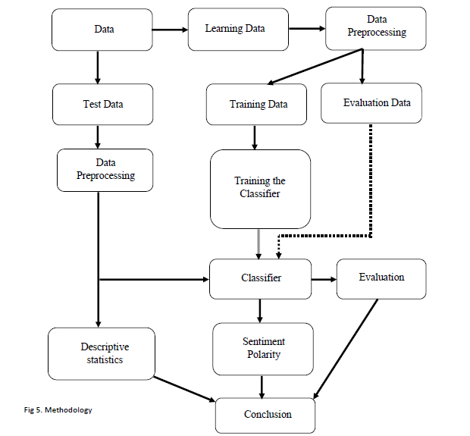
Methodology

Slide 14
Dataset
From these six categories, seven products has been chosen for the analysis. The products present in the test dataset are
Books – The Intelligent Investor
Camera – Nikon D3500
Mobiles – Apple iphone 11 Max Pro and Samsung Galaxy M31
Household – Vim dishwash gel
Entertainment - Echo Input Portable Smart Speaker
Watches - Fastrack Reflex 2.0 Activity Tracker

Slide 15
Dataset(contd.)
Ratings | Learning data | Test data
1-Star | 2406 | 1525
2-Star | 779 | 436
3-Star | 1448 | 740
4-Star | 3524 | 2035
5-Star | 10266 | 6753
Total | 18423 | 11489
Total dataset | 29912

Slide 16
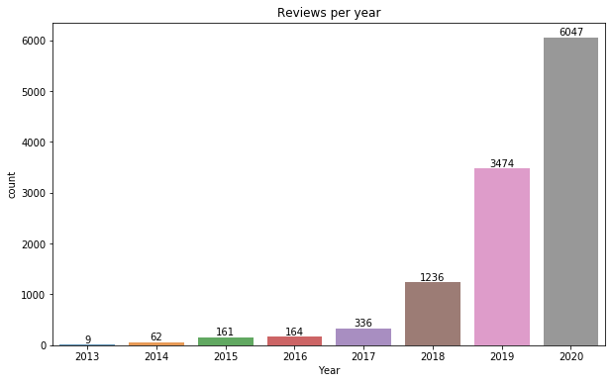
Reviews per Year

Slide 17
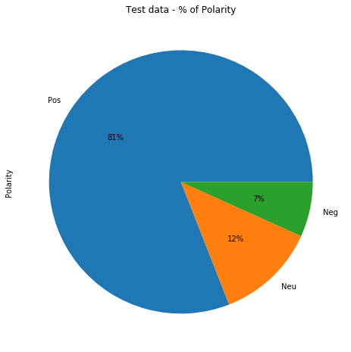
Polarity of the Reviews

Slide 18
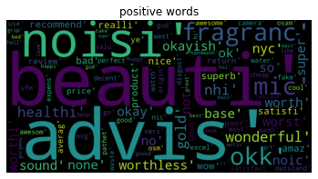
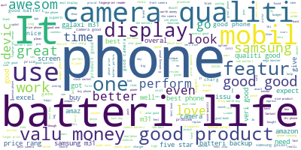
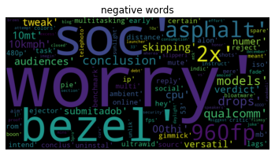
Wordcloud

Slide 19
Term Frequency –Inverse Document Frequency
Smallest | Largest
Worry | Supper
Soc | Help
Bezel | Great
Asphalt | Grip
960fp | Grt
2x | Gud
Conclusion | Handwash
Models | Happy
Drops | Happi
Qualcomm | Hai

Slide 20
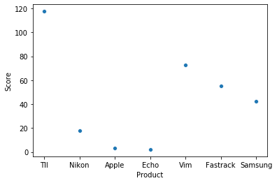
Product Score

Slide 21
Product polarity
Products | Total reviews | Negative % | Neutral % | Positive %
The intelligent investor | 1513 | 3.3% | 21.6% | 75.1%
Nikon D3500 | 713 | 1.8% | 13.3% | 84.9%
Apple iphone 11 Max Pro | 211 | 3.3% | 18.5% | 78.2%
Fastrack activity tracker | 1965 | 14.3% | 19.4% | 66.3%
Vim dishwash gel | 1883 | 3.8% | 19.4% | 76.8%
Echo smart speaker | 204 | 11.3% | 16.2% | 72.5%
Samsung Galaxy M31 | 5000 | 6.6% | 3.4% | 90%
Total | 11489 | 6.8% | 12.3% | 81%

Slide 22
Hypothesis testing
Customer satisfaction may be measured by the gap between perceived quality of the product or service, and pre-purchase quality expectations.
The Customer satisfaction can be expressed in the form of Ratings.
H1: The Customer Sentiment Polarity has a positive impact on the Customer Ratings.
H0: The Customer Sentiment Polarity has no impact on the Customer Ratings.

Slide 23
Test of Normality
The hypothesis variables are categorical data. So the test for hypothesis is Chi-Square test. The test of normality confirms that the data is normal distributed or not.
H0: The data is normally distributed.
H1: The data is not normally distributed.
From the Shapiro-Wilk test, the dataset does not follow a normal distribution as the p-value (7.40959e-071) is less than α.

Slide 24
Chi-Square test
The p-value indicates that these variables are not independent of each other and that there is a statistically significant relationship between the categorical variables.
 | Value | Df | Asymptotic significance (2-sided)
Pearson Chi-Square | 3626.186 | 8 | .000
N of valid cases | 11489

Slide 25
Strength between the Variables
The Phi and Cramer’s V value gives the strength between the two variables. Both the customer sentiment polarity and customer ratings has a strong relation between them.
 |  | Value | Approximate Significance
Nominal by Nominal | Phi | .562 | .000
 | Cramer's V | .397 | .000
N of Valid Cases |  | 11489

Slide 26
Relationship between Customer Ratings and Customer Sentiments
OLS – Multiple Linear Regression
The linear regression gives the relationship between the Customer ratings and the Customer Sentiment Polarity.
The dependent variable is Customer ratings.
The independent variables is Customer sentiment Polarity and subjectivity of the reviews.
Ratings = 5.26 + 1.59(Subjectivity) – 1.02(Polarity).
There exists a multicollinearity between the variables Year, Month, Days, Count and PD score.

Slide 27
Research Question 1:
What are the impacts of customer sentiment on the customer satisfaction?
The impacts of the customer sentiment on the customer satisfaction is analyzed through our hypothesis and proved there is an relationship between them .
The phi and Cramer’s v value shows the strength between the two variables are strong. There is a negative correlation between the two.
The OLS model is Ratings = 5.26 + 1.59(Subjectivity) – 1.02(Polarity).

Slide 28
Research Question 2:
Which classification algorithm will be best suited for the prediction of polarity of the reviews?
The ML classifier trains the model and classifies the evaluating data with its respective classifier.
Based on the Precision, Recall, F1-score and Accuracy, the SVM classifier is the best classifier among NB, DT and K-NN.
SVM is an powerful classifier for text classification.

Slide 29
Research Question 3:
What is the opinion of the customers towards the products?
The opinion of the customers towards the products can be either satisfied or dissatisfied.
The satisfaction of the customer can be understand through the sentiment analysis of the reviews.
The polarity of the reviews are classified into Positive, Negative and Neutral.
The opinion of the customer towards the product can vary based on the product.

Slide 30
Research Question 4:
Which products can be recommended to the customers?
The product with highest positive polarity and product score can be recommended.
The most recommended products are The intelligent investor, Vim dishwash gel, Fastrack activity tracker. The least recommended products are Nikon D3500, Apple iphone 11 Max Pro, and Echo smart speaker.

Slide 31
Conclusion
There is an relationship between the customer satisfaction and customer sentiments.
The customer satisfaction and customer trust impacts the customer behavior to repurchase and revisit the store.
More efficient and quicker than the traditional approach.
SVM is an powerful classifier for text classification.
The opinion of the customer towards the product can vary based on the product.
The product with highest positive polarity and product score can be recommended.

Slide 32
Business implications of the research
Opinion from large volume of reviews
Customer Relationship Management
Product Design
Product & Brand recognition
Consumers shopping decision based on the comparison of product on different features.

Slide 33
Limitations & Future Scope
More number of product can be compared across different categories.
Financial Perspective has not been considered.
The same product sentiment polarity analysis across different E-commerce sites can gives us some valuable insights about the sites and the products.

Slide 34


